Slide 1
Cooked
Mid-Day-Meal
Programme
Annual Work Plan
&
Budget
2018-19
West Bengal
PAB
21/06/2018

Slide 2
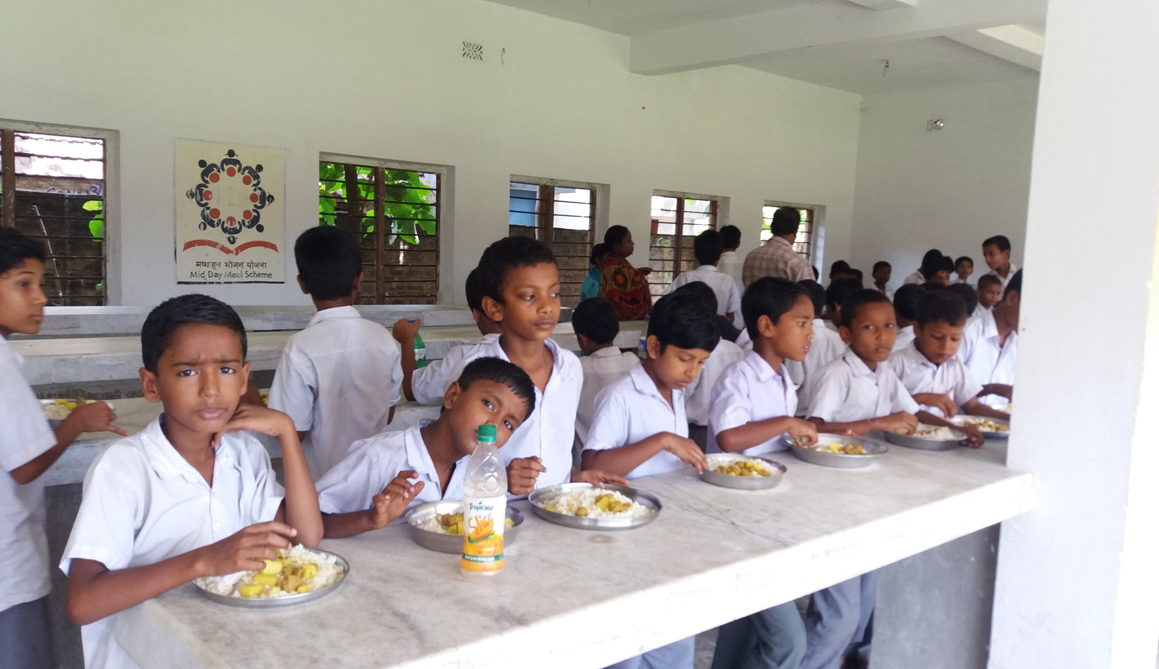
Mid Day Meal Programme
Nagadi obedia High School under Nakashipara Block, Nadia
MDM, WEST BENGAL

Slide 3
Coverage as per AWP &B 2018-19
PRIMARY:
Eligible |  | Covered |  | % of coverage
Schools | Enrolment | Schools | Enrolment | Schools | Enrolment
67536 | 7270889 | 67536 | 6497969 | 100 % | 89.36%
UPPER PRIMARY:
Eligible |  | Covered |  | % of coverage
Schools | Enrolment | Schools | Enrolment | Schools | Enrolment
16154 | 4651274 | 16154 | 4230973 | 100 % | 90.96%
MDM, WEST BENGAL

Slide 4
No. of Children opted for MDMS as per
4th QPR, 2017-18
PRIMARY:
Eligible |  | Covered |  | % of coverage
Schools | Enrolment | Schools | Enrolment | Schools | Enrolment
67536 | 7270889 | 67536 | 7025578 | 100% | 96.63%
UPPER PRIMARY:
Eligible |  | Covered |  | % of coverage
Schools | Enrolment | Schools | Enrolment | Schools | Enrolment
16154 | 4651274 | 16154 | 4483920 | 100% | 96.40%
MDM, WEST BENGAL

Slide 5
Utilization of Fund & Food Grains
During 01.04.2017 to 31.03.2018
(Rs in Lakh)
Components |  | Allocation for 2017-18 | O/B | Fund released | Availability of fund | Utilization | % of expenditure against allocation
Cooking Cost | Pry | 67311.60 | 10502.63 | 60573.44 | 71076.07 | 59739.71 | 89%
 | Up. Pry | 69127.47 | 9383.55 | 61972.48 | 71356.03 | 60065.76 | 87%
Transportation cost |  | 2309.32 | 776.48 | 1532.84 | 2309.32 | 1501.58 | 65%
Management Monitoring & Evaluation (MME) |  | 1951.07 | 7.34 | 1943.73 | 1951.07 | 1951.07 | 100%
Honorarium to cook cum Helpers |  | 37319.85 | 2236.76 | 37319.85 | 39556.61 | 35465.04 | 95%
Cost of Food grains |  | 9237.28 | 4023.05 | 5214.24 | 9237.29 | 6006.31 | 65%
TOTAL |  | 187256.59 | 26929.81 | 168556.58 | 195486.39 | 164729.47 | 88%
Component |  | Allocation for 2017-18 | O/B | Lifting | Availability of food grains | Utilization | % of expenditure against allocation
Food grains/Rice (in MT) |  | 330767.22 | 22857.74 | 200210.26 | 223068.00 | 199350.02 | 60%
MDM, WEST BENGAL

Slide 6
Status of Payment to FCI
As on 31.03.2018
(Rs. In Lakh)
Allocation for FY 2017-18 | Opening Balance as on 01.04.17 | Central Assistance Released by GOI | Bills raised by FCI |  | Payment to FCI |  | % of payment to FCI against bills raised
 |  |  | Qty (in MTs) | Amount (in Lakh) | Qty (in MTs) | Amount (in Lakh)
9923.02 | 4023.05 | 5214.24 | 200210.25 | 6006.31 | 200210.25 | 6006.31 | 100%
 | Lifting (MT) | Bill Raised (Lakh) | Bill Payed (Lakh)
FCI | 134904.17 | 4047.13 | 4047.13
DCFS | 65306.08 | 1959.18 | 1959.18
Total | 200210.25 | 6006.31 | 6006.31
MDM, WEST BENGAL

Slide 7
Status of kitchen cum store
As on 31.03.2018
Total No. of eligible schools | Unit Sanctioned | Completed | In Progress | Proposal
82099 | 81314 | 77293 (95.05%) | 4021 | 268
MDM, WEST BENGAL

Slide 8
Procurement of kitchen devices
As on 31.03.2018
Total No. of eligible schools | Total No. of sanctioned units + Replacement | Procured | Proposal for replacement
83690 | 138598 | 138598 | 40874
N.B: Fund for replacement of Kitchen Devices (49981) amounting to Rs. 2499.05 lakh has been sanctioned in the F.Y. 2015-16 but only Rs. 390.51 lakh (7810 unit) has been received in 2016-17. Hence in the FY 2018-19 Rs. 2108.54 lakh (42171) may kindly be released immediately.
MDM, WEST BENGAL

Slide 9
Requirement of Cook cum helpers 2018-19
During 01.04.2016 to 31.03.2018
Cook Cum Helpers Sanctioned | CCHs Engaged during 2017-18 | Proposed (2018-19)
248799 | 235165 | 248799
MDM, WEST BENGAL

Slide 10
Data Entry Status (TRGMDM) for 2017-18
MDM, WEST BENGAL

Slide 11
Automated Monitoring System
AMS has started from November’17.
Total number of schools – 83690.
Total number of schools registered– 82430 .
On an average 85% schools are reporting on daily basis.
MDM, WEST BENGAL

Slide 12
Initiatives taken & Good practices by State Govt.
Dining Halls for backward areas:- 1403 dining halls have been constructed out of State exchequer and 1570 dining halls from MP-LAD.
LPG :- At present 31499 (38%) institutions are using LPG for cooking MDM. Another grant of Rs. 9.21 Cr has been released from the State exchequer for installation of LPG in 18435 No. of schools.
Fire Extinguisher :- Installation of Fire Extinguishers in 57996 no. of schools has already been completed out of State Govt. fund.
Plates and glasses:-From State Fund 80 lakh units of plates and glasses have been purchased and distributed to the students.
Hand Washing:- Hand washing with soap is being followed in all the schools before taking MDM.
Engagement of Education Supervisor:- 731 Education Supervisors for each Educational Circle have been engaged for better monitoring and reporting progress of Mid-Day Meal, SSA & RMSA Programmes.
Additional honorarium to cook-cum-helpers:-The State Government has allowed Rs. 500/- as additional honorarium per month per Cook cum helpers apart from state share since October, 2013.
Kitchen garden:- Kitchen garden in 6025 schools have been developed and another 941 is in progress.

Slide 13
Decisions taken at SLMC Meeting
Third Party Audit for Monitoring:- Third party audit of MDMS the mechanism of P & RD should be considered alongside other officials for monitoring purpose.
Supply of Piped drinking water: Supply of piped drinking water to all the schools wherever piped water supply is available may be ensured by the PHE Deptt.
Plantation of fruit bearing trees:- Plantation of fruit bearing trees within the school compound in consultation with the P & RD, FH & FP Deptt. should be explored.
Booklet on MDM:- A Booklet on best practices should be developed and share with all districts.
Construction of more Dining Halls:- More Dining Halls should be build in the coming year.
Regular Inspection:- Regular Inspection specially in Urban areas should be increased.
MDM, WEST BENGAL

Slide 14
Initiatives taken & good practices by Districts
Additional Food Item: Eggs are served once a week in all Districts. Chicken 50 gm per child served once a month in 12 Districts. Paneer and Cheese also served in some Districts.
Special Mid-Day Meal Monitoring drive: Purba Bardhaman and Murshidabad took the initiative of single day inspection of running of Mid-day Meal.
MDM Mela-cum-Workshop & Training Programme:- Malda District Administration has arranged two days Mid day Meal Mela-cum-Workshop & Training programme of CCH with a view to improve the quality of cooked MDM.
MDM Magazine for all Schools: Malda District Administration has prepared a Magazine on preparation of low cost, hygienic and tasty food.
Testing of food samples:- This is being taken up by the Accredited laboratories during this year.
MDM, WEST BENGAL

Slide 15
Budget Proposal for 2018-19
Rs. In Lakh
Components |  | Central | State | TOTAL
Cooking Cost | Pry | 36899.91 | 24550.34 | 61450.25
 | Up. Pry | 36436.73 | 24258.42 | 60695.15
Transportation cost |  | 2220.81 | 0.00 | 2220.81
Management Monitoring & Evaluation (MME) |  | 1788.64 | 0.00 | 1788.64
Honorarium to cook cum Helpers |  | 14927.94 | 22391.91 | 37319.85
Cost of Food grains |  | 8883.25 | 0.00 | 8883.25
Kitchen device |  | 2043.70 | 0.00 | 2043.70
Kitchen Store |  | 461.50 | 307.66 | 769.16
TOTAL |  | 103662.47 | 71507.66 | 175170.13
MDM, WEST BENGAL

Slide 16
ISSUES / PROPOSALS
In the meeting of the SLMC the present rate of cooking cost was considered very low and it was decided to form a committee in this regard. As per recommendation a proposed estimate is being prepared as under:
Primary: Rs. 8/- and Upper Primary: Rs. 10/- per student per day.
Raising of MME fund from 1.8% to 3% to meet up salary expenses of approximately 2000 contractual employees working under MDMS at different levels.
Remuneration to the Cook-cum-helpers may be paid for 12 months instead of 10 months in a financial year. It is also proposed to enhance the remuneration @ Rs. 1,000/- per cook per month by the MHRD, GOI.
Rs. 5,000/- for kitchen devices is inadequate for schools with higher enrolment the amount may be enhanced accordingly.
Initial installation charges for LPG connection need to be considered by the MHRD, GOI.
MDM, WEST BENGAL

Slide 17
WEST BENGAL
“PHOTO SESSION”
MID – DAY MEAL
SCHEME

Slide 18
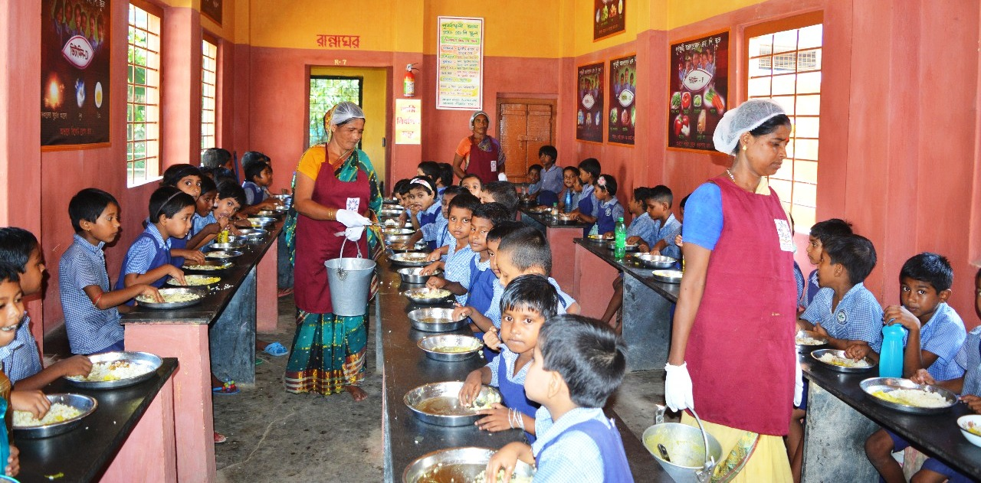
Mid Day Meal Programme
Dining Hall
Purbasthali Annadaprasad F.P. School, Purbasthali, Purba Bardhaman
MDM, WEST BENGAL

Slide 19
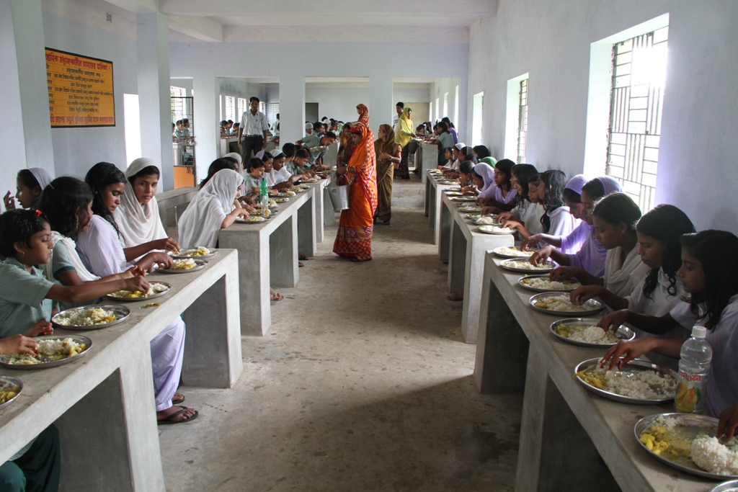
Mid Day Meal Programme
Dining Hall
Dining at Dr Jakir Hossain High Madrasah under Tehatta-1 Block, Nadia
MDM, WEST BENGAL

Slide 20
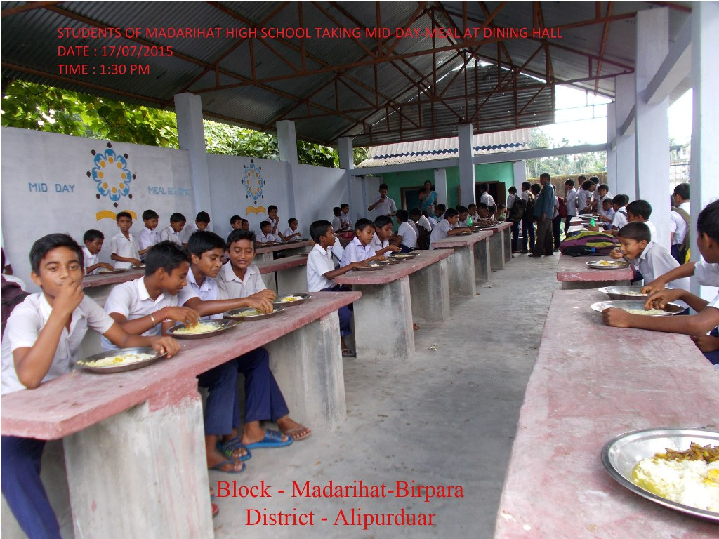
Mid Day Meal Programme
Dining Hall
Madarihat High School, Madarihat-Birpara, Alipurduar
MDM, WEST BENGAL

Slide 21
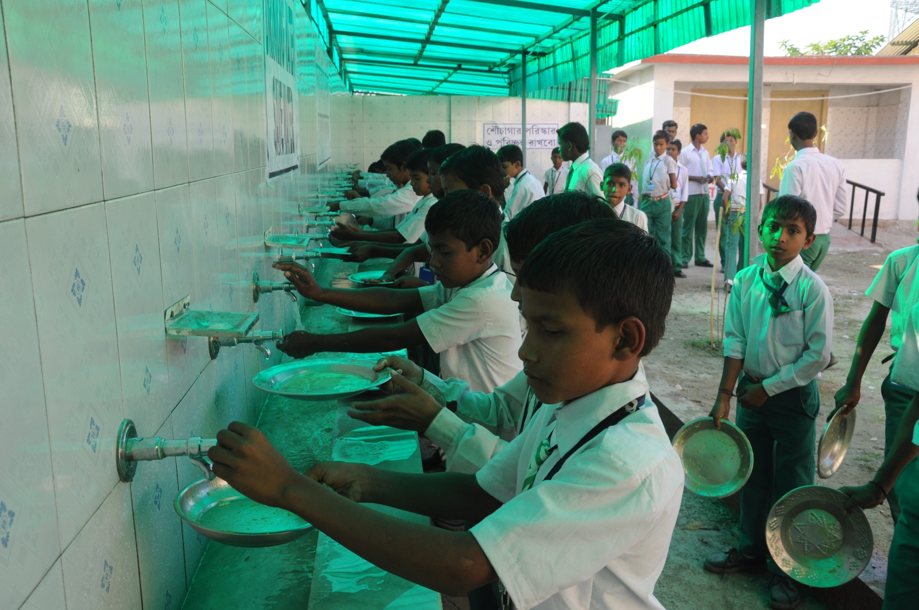
Mid Day Meal Programme
Hand Washing
Muraliganj High School, Siliguri
MDM, WEST BENGAL

Slide 22
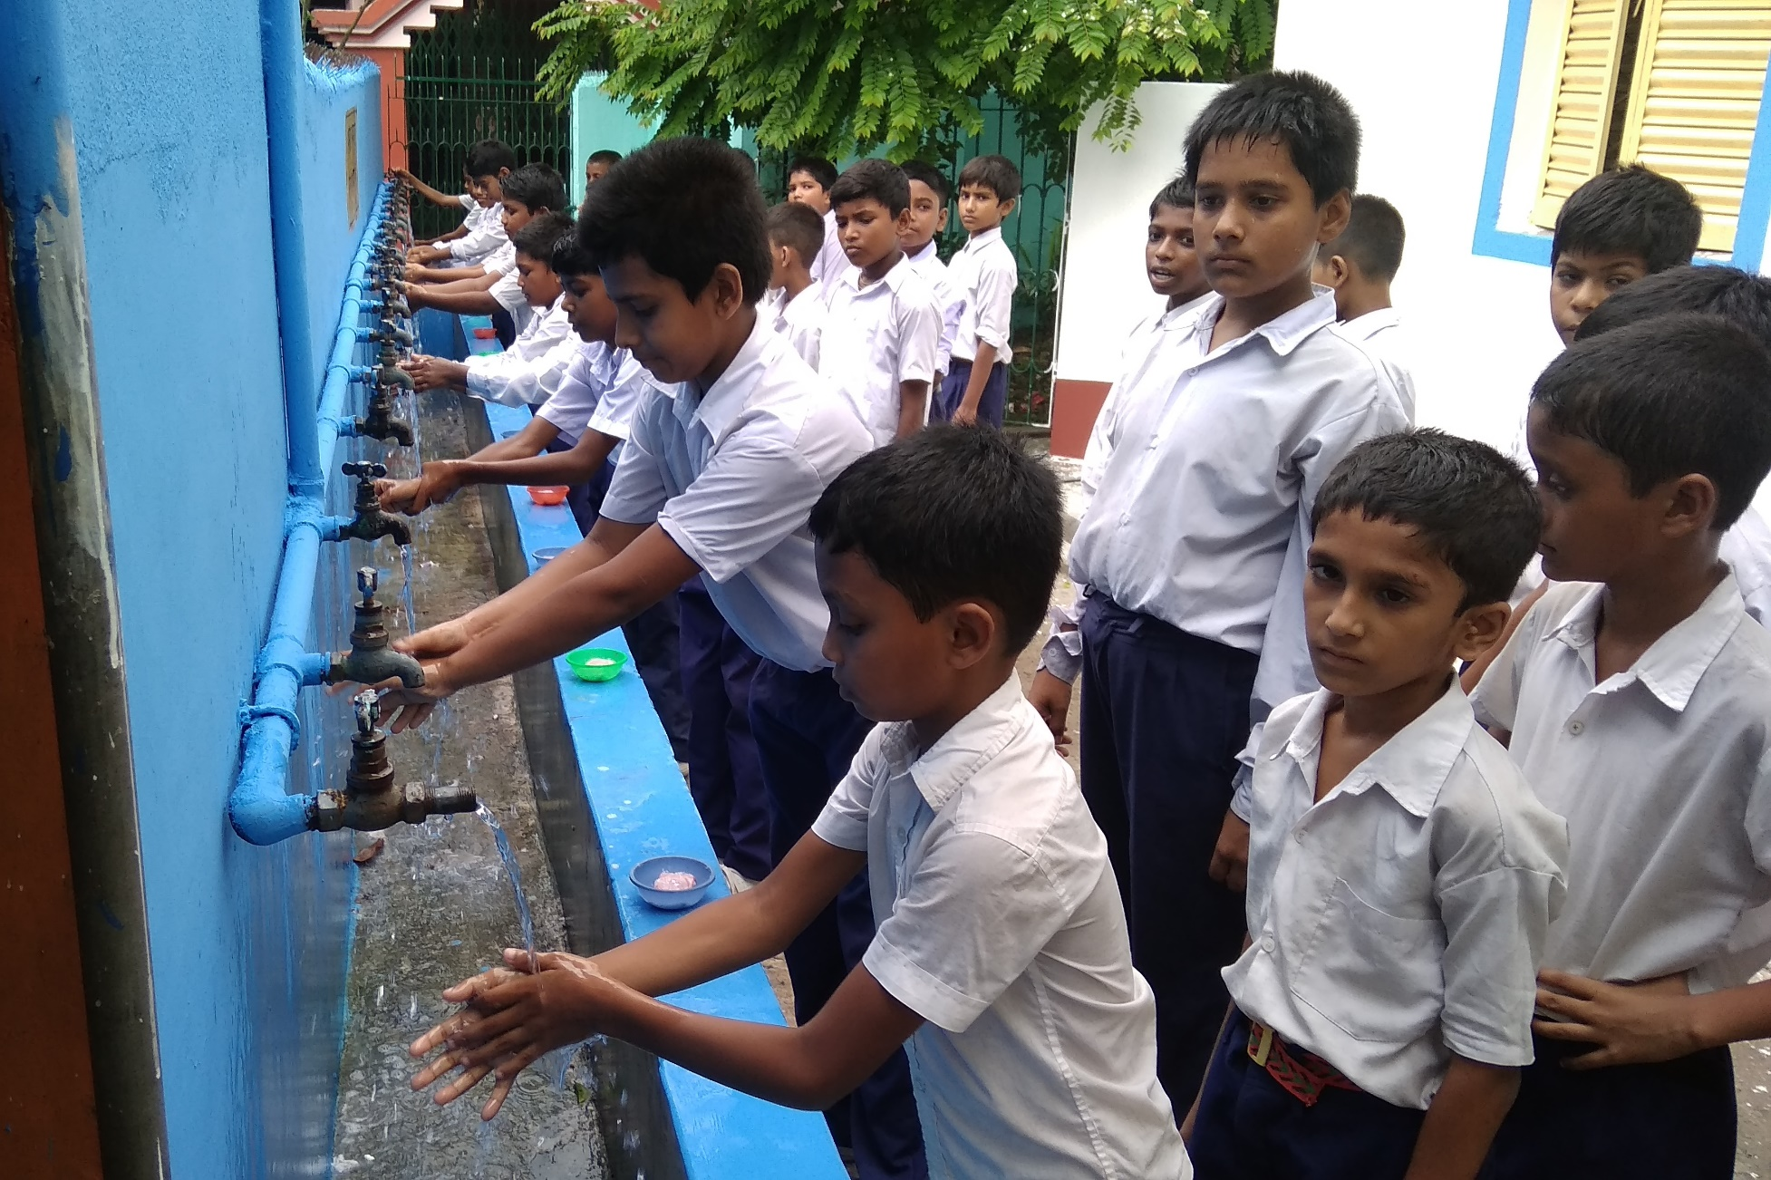
Mid Day Meal Programme
Hand Washing
Hand Washing at CSTEV(HS) under Kalyani Municipality, Nadia
MDM, WEST BENGAL

Slide 23
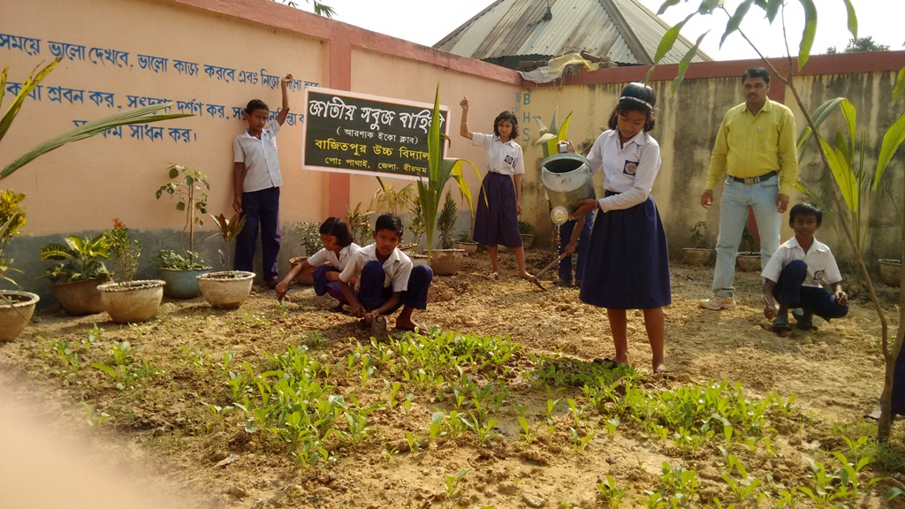
Mid Day Meal Programme
Kitchen garden
Kitchen Garden at Bajit pur High School, Mayureswar I , Birbhum
MDM, WEST BENGAL

Slide 24
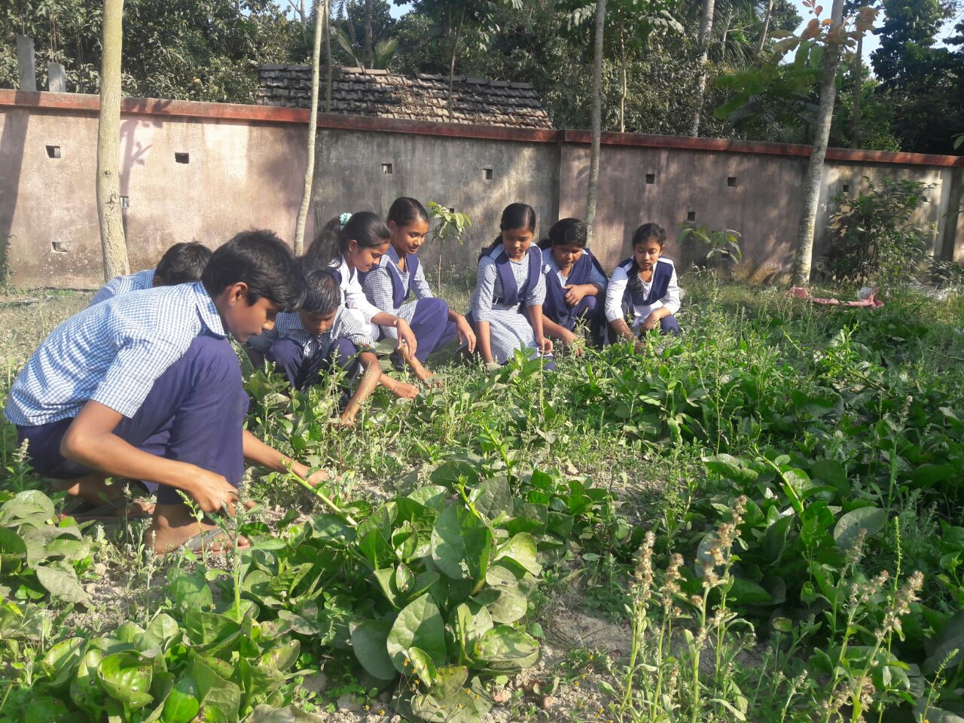
Kitchen garden
Mid Day Meal Programme
Ainshmali United Academy School under Ranaghat-II, Nadia
MDM, WEST BENGAL

Slide 25
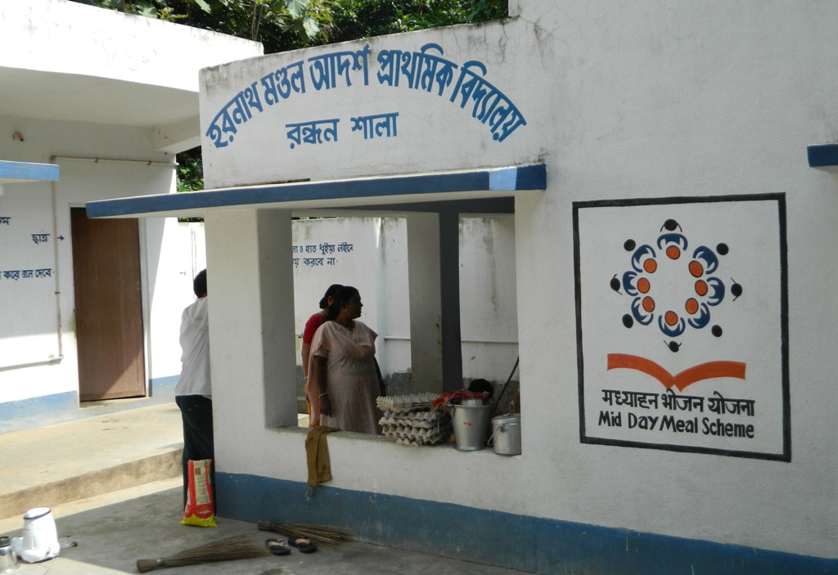
Mid Day Meal Programme
Kitchen shed
Haranath Mondal Adarsha Primary School Suri Municipalty, Birbhum
MDM, WEST BENGAL

Slide 26
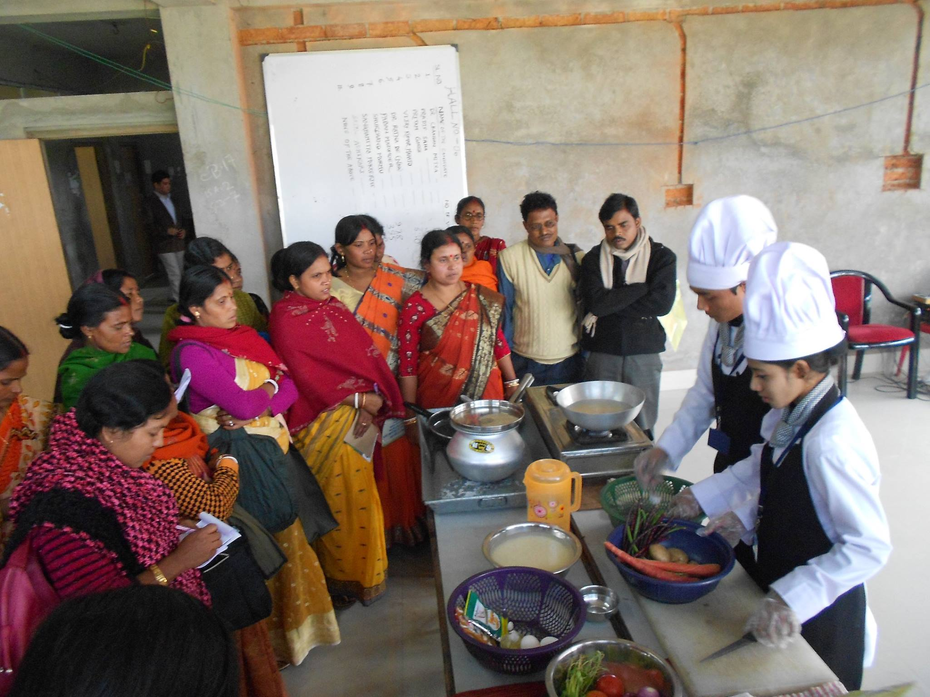
Mid Day Meal Programme
Training of cch
Training of Cook-cum-helpers at Hooghly
MDM, WEST BENGAL

Slide 27
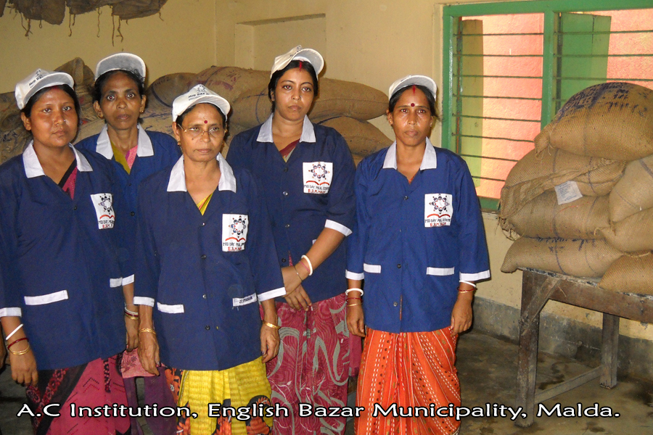
Mid Day Meal Programme
Cook cum helpers
MDM, WEST BENGAL

Slide 28
Mid Day Meal Programme
Plates & Glasses
MDM, WEST BENGAL

Slide 29
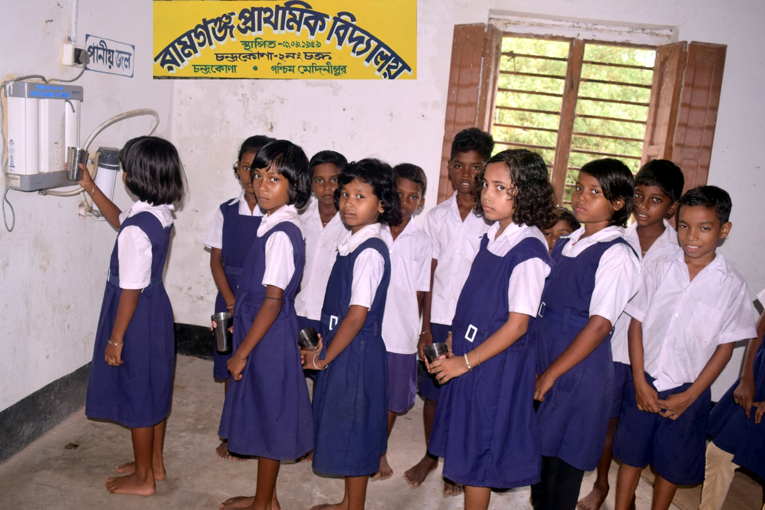
Mid Day Meal Programme
Water filtration
Ramganja Primary School under Chandrakona Municipality, Paschim Medinipur
MDM, WEST BENGAL

Slide 30
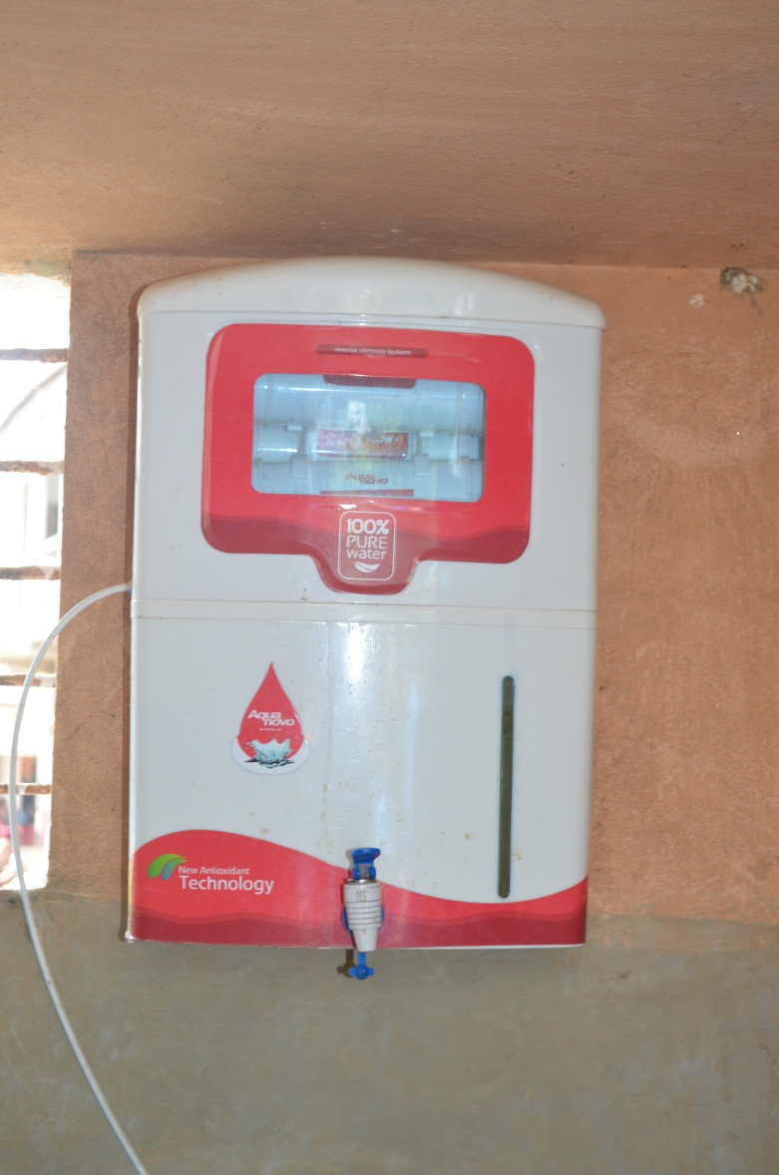
Mid Day Meal Programme
Water filtration
Water Filter installed in Ramchandrapur Asutosh Pry.School, Paschim Medinipur
MDM, WEST BENGAL

Slide 31
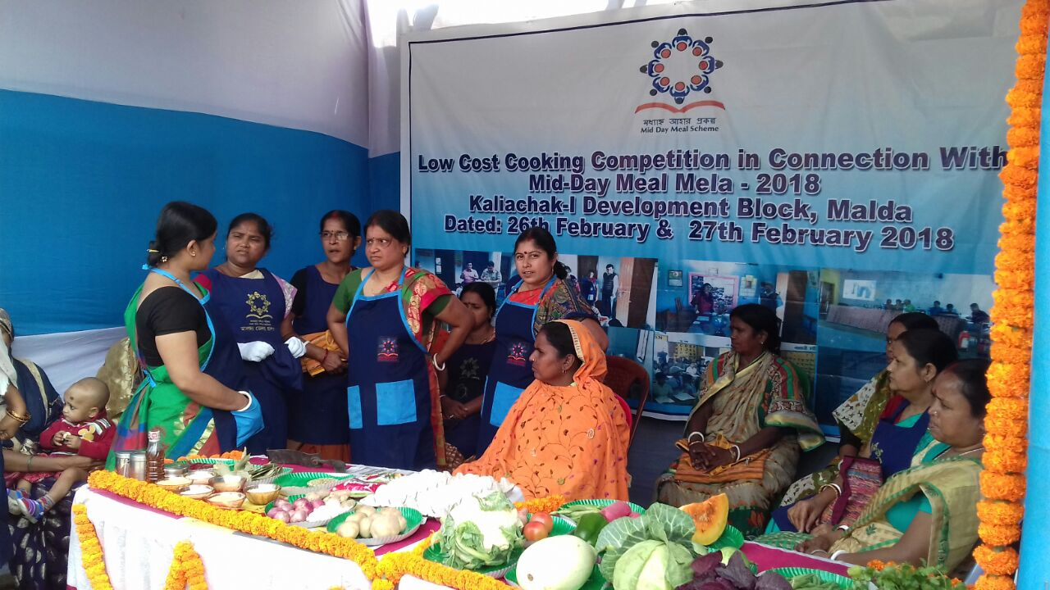
Mid Day Meal Programme
Mid day meal mela
Mid-Day Meal Mela at Malda District
MDM, WEST BENGAL

Slide 32
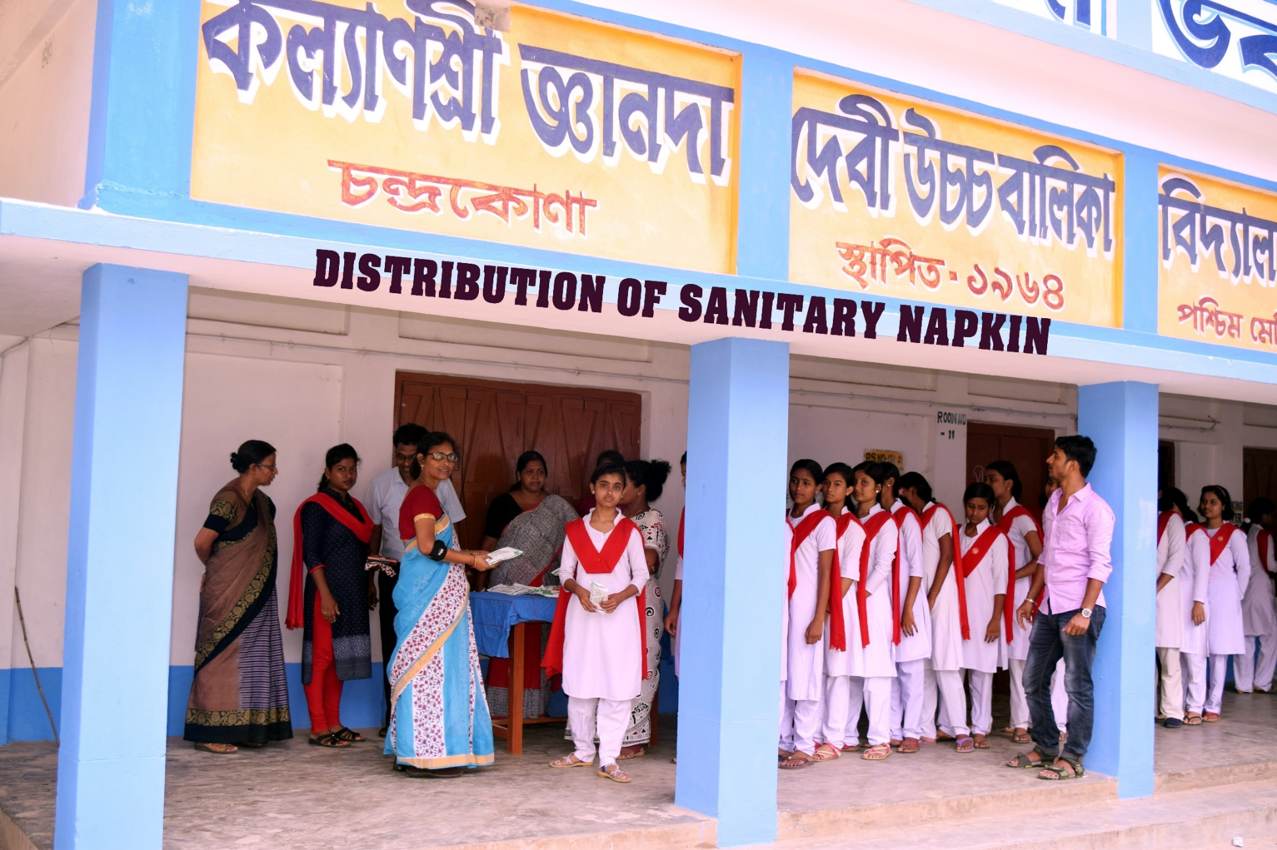
Mid Day Meal Programme
Kalyanshree J.D. Girls School (H.S.) under Chandrakona Municipality, Paschim Medinipur
MDM, WEST BENGAL

Slide 33
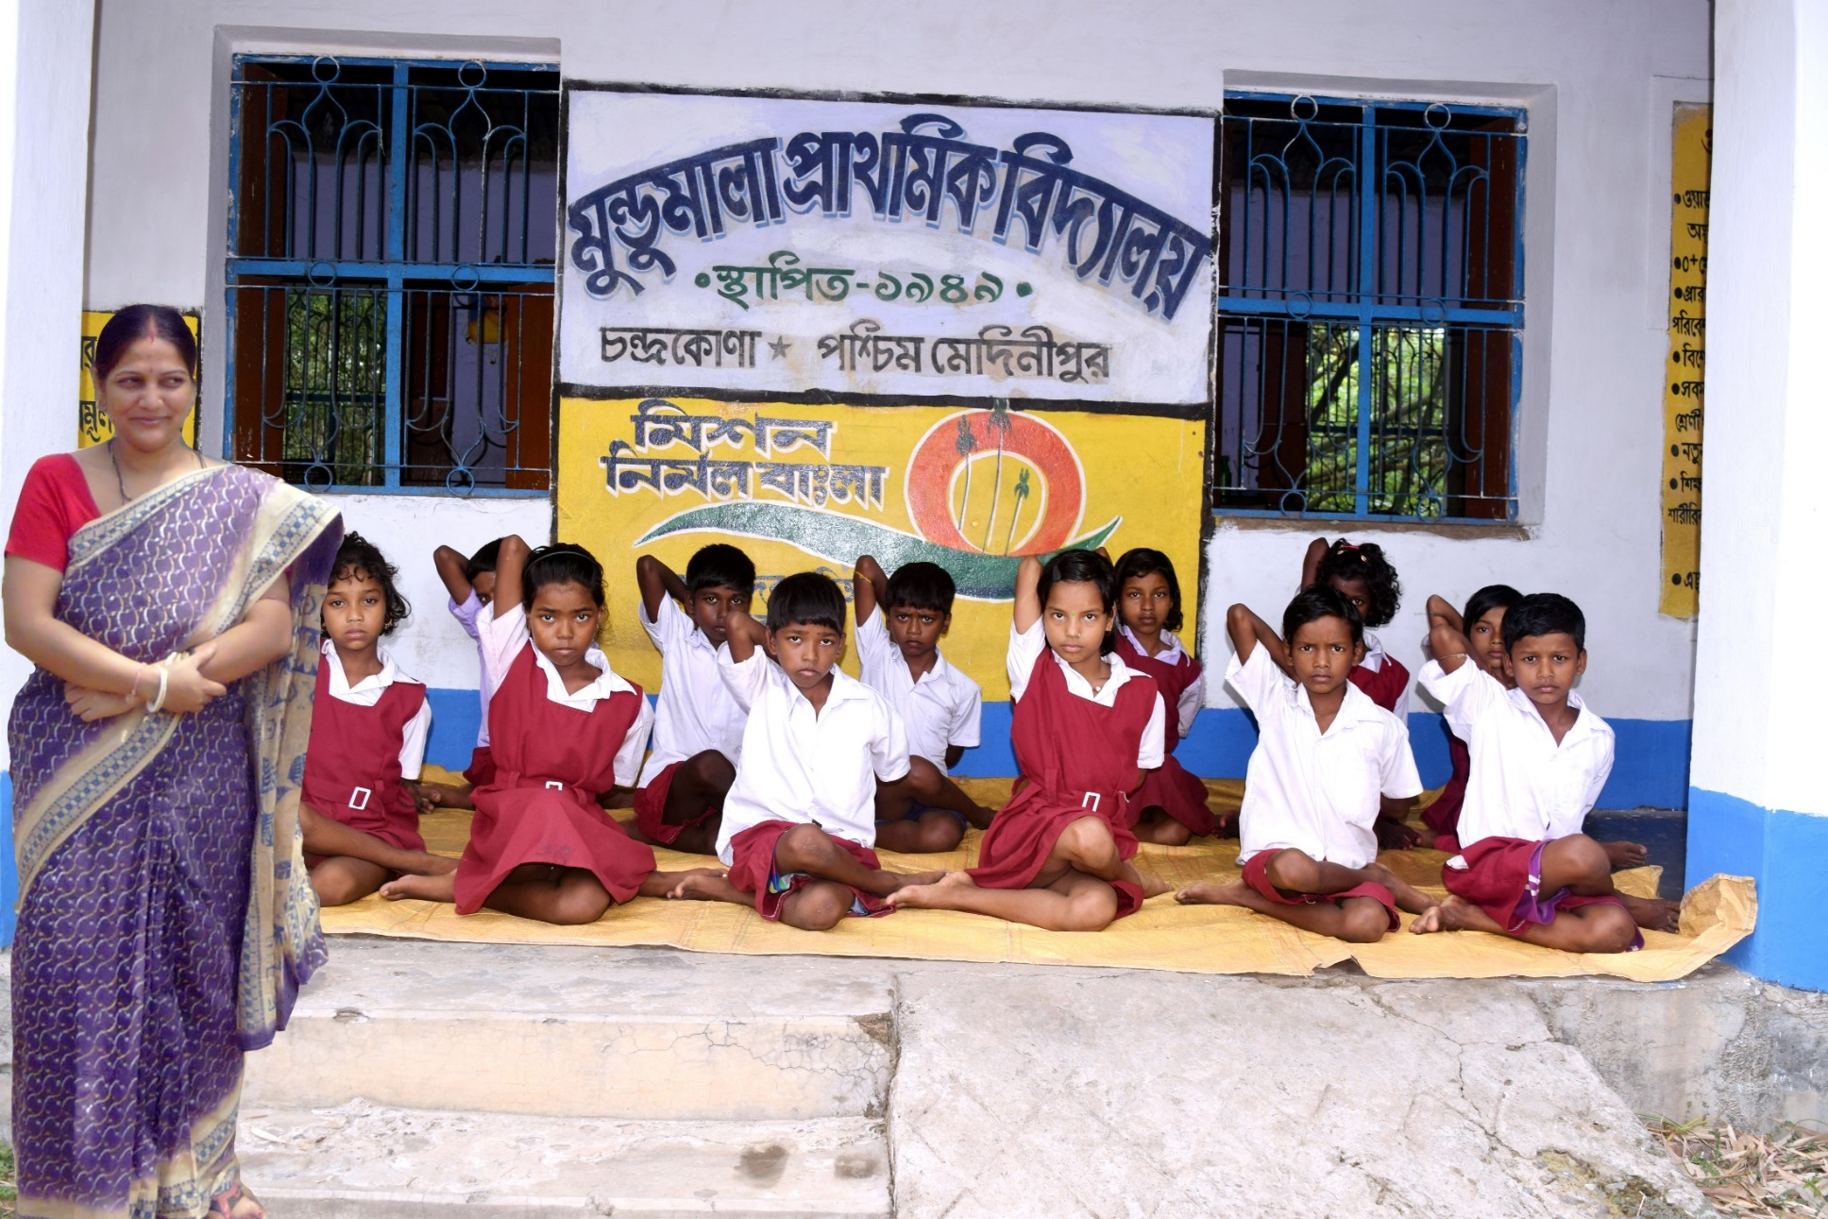
Mid Day Meal Programme
yoga class
Mundumala Primary School under Chandrakona Municipality, Paschim Medinipur
MDM, WEST BENGAL

Slide 34



THANK YOU
Govt. of West Bengal
School Education Department
Mid Day Meal Section

